Slide 1
JavaScript for the .NET convert
AJS322
Ward Bell
IdeaBlade
email: wardb@ideablade.com twitter: wardbell

Slide 2
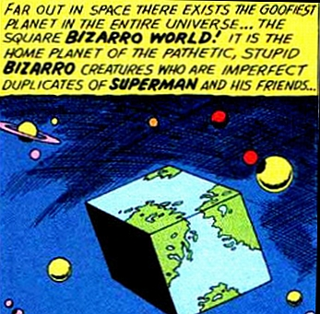
JavaScript … like C# … but not

Slide 3
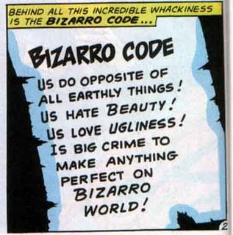

Slide 4
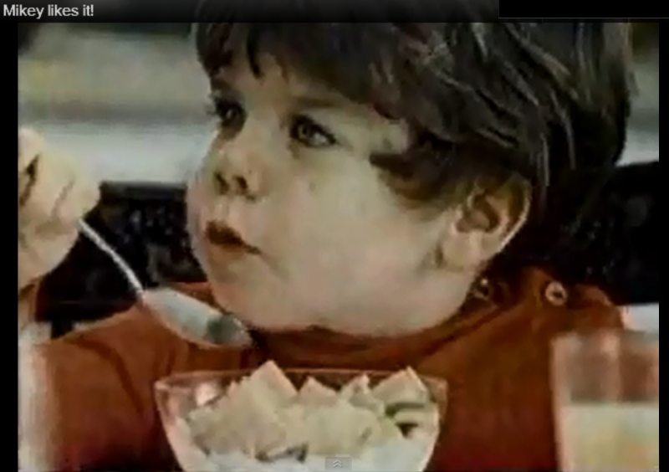

Slide 5

History of JavaScript
Created by Brendan Eich in 1995
Written in 10 Days
Based on Scheme and Self “I still think of it as a quickie love-child of C and Self”

Slide 6
Fast JavaScript Engines
Mozilla
SpiderMonkey, Rhino, Narcissus
Google
V8
Safari
SquirrelFish
Microsoft
Chakra

Slide 7
Basic data types
boolean – true, false
number – 42, 3.14
string – "Hello World "
object – { name: "Ward“ }
undefined – variable not yet assigned a value
null – variable does not represent an object

Slide 8
Dynamic
Dynamic Languages
JavaScript
Ruby
Common LISP
Smalltalk
Static Languages
Java
C#
VB.NET
JavaScript is a dynamic and functional language
That often confuses C# and VB.NET developers

Slide 9
Loose typing
var foo = "Some string"; // string foo = 42; // number
foo = new Date(); // date foo = true; // boolean foo = []; // empty array foo = [1, "two", 1+2]; // heterogeneous array foo = { first: "Ward", last: "Bell" }; // object foo = function() { return "Hello, world!"; }; // function

Slide 10
Duck typing
var Dog = function(name) { this.name = name; }
Dog.prototype.speak =
function() { return log( this.name + " says Woof!");}
var fido = new Dog("Fido");
fido.speak();
var Duck = function(name) { this.name = name; } var don = new Duck("Donald"); //don.speak(); // Ducks can't speak
Duck.prototype.speak =
Dog.prototype.speak;
don.speak(); // says "Woof!" Duck.prototype.speak = function() { return log(
this.name + " says Quack!");} don.speak(); // says "Quack!"

Slide 11
Objects are hash tables
var hash = { red: "rouge", blue: "bleu" }; hash.green = "vert";

Slide 12
Fields, not properties!
var hash = { red: "rouge", blue: "bleu" }; hash.green = "vert";
“red” can’t have behavior
“red” can’t be observable (no INotifyPropertyChanged)
“red” can be set by anyone, anytime

Slide 13
Arrays are integer indexed hashes
var array = [1, 2, 3]
array[1]; // zero origin; returns 2 array[10] = 11; array.length; // 11 array["red"] = “rouge" // perfectly fine
array.length; // take a guess
console.log(array); // take a guess
array.red; // take a guess ​

Slide 14
Use literals for objects and arrays
{ } and [ ]; // not new Object, not new Array

Slide 15
Array length
var a[], b[];
a[0]=0; a[10]=10; // what is length?
b[0]=1; b[1]=2; b.three=3; // what is length?

Slide 16
Iterating
for …
for … in // objects
for (;;) // arrays … or forEach

Slide 17
ECMAScript 5 array methods
forEach()
map()
filter()
reduce()
reduceRight()
indexOf()
lastIndexOf()
every()
some()
supported by modern browsers today
shims for older browsers

Slide 18
False-y and Truth-y
False-y:
false, 0, null, undefined, "", NaN
Truth-y: everything else
true, 1, { }, function() { }, "false"

Slide 19
False-y and Truth-y
C#:
if (str != null && str.length > 0) …
if (!String.IsNullOrEmpty(str)) …
JS:
if (str) …

Slide 20
Default value
C#:
if (val == null) { val = 0; }
val = val ?? 0;
JS:
val = val || {}; // idiomatic abuse of OR

Slide 21
Too Cute
var array = [1, 5, -1, 0, 10, -100]; var len = array.length, i, max = Math.max(); log(max); // -Infinity, the identity value for Math.max for (i = 0; i < len; i++) { // abusing the && operator
// if left is true, right updates max array[i] > max && (max = array[i]); } log(max);

Slide 22
Comparison === / !===

Slide 23
Global namespace
var g1 = "one";
g2 = "two";
window["g3"] = "three";
this["g4"] = "four";
function doSomething() { g5 = "five"; }
var a = b = 3; // watch out! 'b' is global!

Slide 24
Stop global pollution
Why it matters
Use namespaces
Use IIFEs (huh? we’ll explain later ☺)

Slide 25
Functions are 1st class objects
Like objects they can be …
created via literals
assigned to variables, array entries, and objects
passed as arguments to functions
returned as values from functions
possess their own properties
“Secrets of the JavaScript Ninja”

Slide 26
functions expression or statement?
var wait5Seconds = function () {
console.log("I'm back!");
});
function wait5Seconds () {
console.log("I'm back!");
});
If it starts with “function” it’s a statement
function statement is hoisted; expression is not.

Slide 27
anonymous function expressions
var wait5Seconds = function () {
console.log("I'm back!");
});
window.setTimeout(wait5Seconds, 5 * 1000);
window.setTimeout(
function () {
console.log("I'm back!");
}, 5 * 1000);

Slide 28
variable hoisting

Slide 29
functions scope
function scope v. block scope
function hoisting

Slide 30
Best Practice
Declare all variables at the top of your function

Slide 31
Constructor functions
// Kinda ... sorta ... a class
function Product(name, price) {
this.name = name;
this.price = price;
this.displayPrice = function () {
console.log(this.price);
};
}
var milk = new Product("Milk", 2.99);
milk.displayPrice(); // logs 2.99

Slide 32
"this" … is a subject for another day

Slide 33
Async events
Browser e.g., when a page is finished loading or when it is to be unloaded.
Network e.g., responses to an AJAX request.
User e.g., mouse clicks, mouse moves, or key presses.
Timer e.g., a timeout expires or an interval fires.

Slide 34
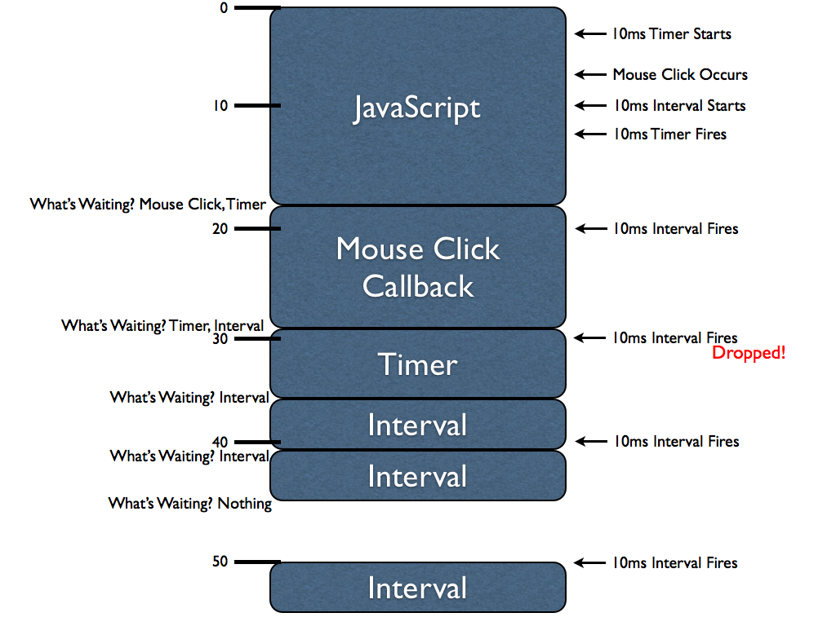
Single thread & the event loop
http://ejohn.org/blog/how-javascript-timers-work/

Slide 35
Closure
Capture outer variables within a function

Slide 36
Closure - example
var unorderedList = $( "ul" ), i;
for (i = 0; i < 10; i++) { $("<li />", { id: i, text: "Link " + i, click: function(ix) { return function() { console.log("You've clicked " + ix); } }(i) }).appendTo( unorderedList ); }​

Slide 37
IIFE Immediately-Invoked Function Expression
(function () {console.log("hi there");})();
(function () {console.log("hi there");}());
outer () disambiguate function expression from statement.
can “lock in” values and save state.
minimize global scope pollution and create privacy

Slide 38
Module patterns
Old school
Singleton
IIFE (immediately invoked fnc exec)
Revealing module
AMD (require)

Slide 39
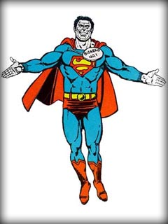
It JavaScript
It Good

Slide 40
Resources
Mozilla Developer Network (MDN)
JavaScript: The Good Parts
JavaScript Patterns
Dan Wahlin on JS patterns
PluralSight
WTF JS (my fiddles)
WAT (the funniest 4 minutes in technology)

Slide 41
JavaScript for C# Developers
PluralSight course by Shawn Wildermuth
Comparing C# and JavaScript
Why functions are different than methods
Object-oriented JavaScript
Architecting JavaScript code
And more…
http://shawnw.me/js4cscourse

Slide 42

Your Feedback is Important
Please fill out a session evaluation form
drop it off at the conference registration desk.
Thank you!
AJS322:JavaScript for the .NET convert

